Slide 1
Engaging with climate change by connecting with Asia Sound impossible - well here's how Jim Crosthwaite Helen Dobbyn, Jack Schmidt, Holly Dillabough, Chris Leslie, Kaz Donkers
www.jcj.org.au

Slide 2
Pressures to disengage
I’m sick of always opposing
It’s global
I may as well fly, everyone else does
We’re alone, and it is a slog
Our approach
Grassroots initiatives can nourish the spirit
Let us build links & work with particular people in Asia
If you fly, help fund catalysts for change
Visit activists in regional Victoria, and go bush walking too

Slide 3
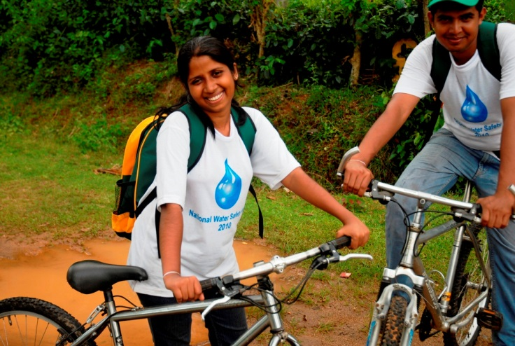
JCJ since 2011 launch
Balance our carbon use
$11,000 to 12 day Kelani River Journey in Sri Lanka – 21 youth
Youth climate leadership
$1,000 to BGreen Conferences in Bangaldesh – 100+ youth
$5,000 to 10 day Paapedi Bike Journey in Sri Lanka – 20+ youth
“We aim to address the inequitable impacts of climate change, which often fall on communities that have contributed the least to the problem and have the least resources to cope with them”

Slide 4
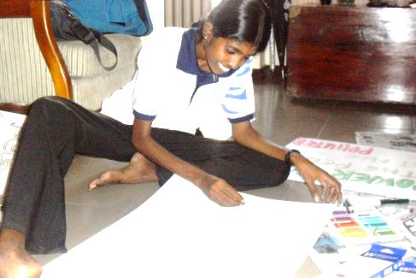
Outcomes
17+ of the 50 youth on both Journeys are still active
Gayani – participant Kelani River Journey
Ran two environmental workshops in home-town
Became a leader for the 2013 Papeedi bike journey
Now a full-time archeologist
Promoting environmental activities at work - not part of her job – tree planting, establishing a plant nursery, reducing garbage, and stopping burning of plastics.

Slide 5
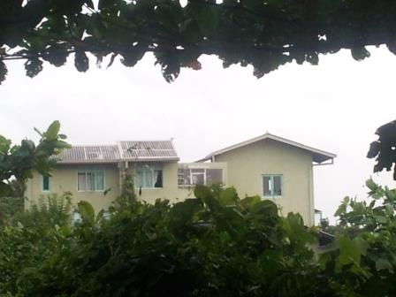
Responding to Asian energy demand
Renewables instead
Push demand reduction
Counter Australian coal promotion
JCJ proposal
link technical experts
create debate
empower ordinary people to act
Australia and Asia – let’s go for 100% renewables!
Eco-friendly house in Colombo

Slide 6
Our project Asia and Australia for 100% renewables
Who – Steven Bygrave, CEO of BZE
Where – Sri Lanka
When – August 2015
Cost - $3,340
Later expand to other countries

Slide 7
What $3,340 will achieve
4 sustainability conferences in Colombo, Kandy, Galle and Anuradhapura
Meetings with engineers, government officials, academics, NGOs, and industry leaders
Extensive media coverage
Links with enthusiastic environmentalists

Slide 8
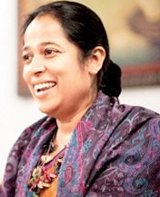
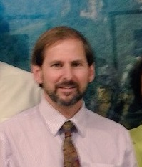
How
In-country organising
Kanchana Weerakoon, Founder Eco-Friendly Volunteers (www.eco-v.org)
Proven track record
Kelani River Journey 2011
Paapedi Bike Journey 2013
Youth meetup 2015
Mentor to youth in Sri Lanka & Bangladesh
Technical expertise and communications
Steven Bygrave, CEO Beyond Zero Emissions (www.bze.org.au)
excellent communicator
knowledgeable in economy-wide alternatives to coal
knowledgeable about community-based renewable energy.

Slide 9
Call for action
A little goes a long way
$720 already pledged
Target $3,340
Budget
Australia – airfare ~$1,500, other $195
Sri Lanka – accomm/food $462, travel $411, venues/catering $923
Contingency - $200
Please support
Give us your pledge today
Endorsed by
Cam Walker – FOE
Charlotte Wood – 350.org
Steven Bygrave – BZE
Carol Ride - DCAN

Slide 10
Contribute to the project at www.jcj.org.au/donate
More information and full project details
Visit www.jcj.org.au
Contact Jim Crosthwaite 0488 956 506 jimxwaite@pacific.net.au
Follow us
www.facebook.com/journeysforclimatejustice
https://twitter.com/JourneysClimJus

